Slide 1
Bite-Sized Storytelling: Stories, Reels, and More
Jules Laughlin (DOTS), Whitney Schepf (STAMP),
& Taylor Smyth (Intercollegiate Athletics)

Slide 2
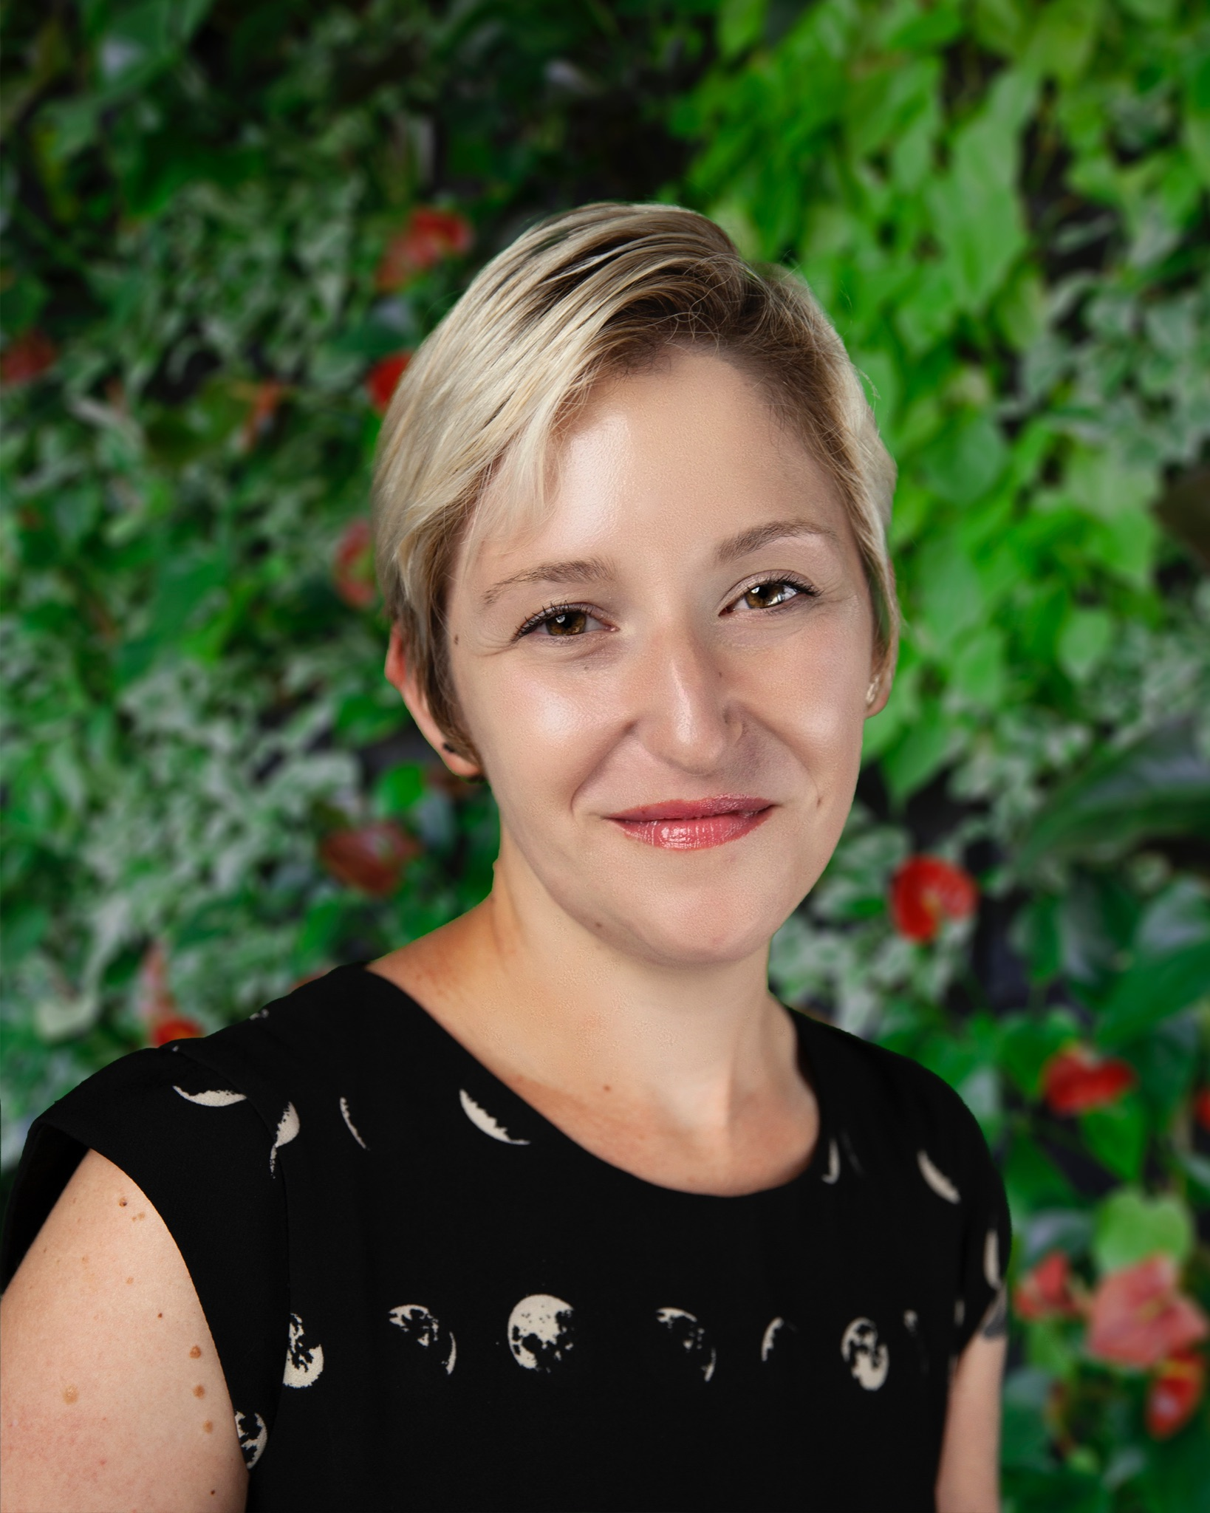
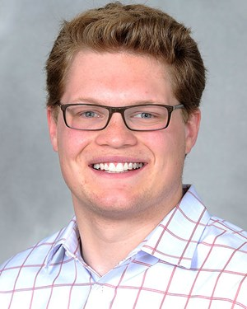
Who We Are & What We Do
JULES LAUGHLIN
Communications and Outreach Specialist, Department of Transportation Services
@dots_umd
WHITNEY SCHEPF
Coordinator for Marketing & Communications
STAMP
@thestampumd
TAYLOR SMYTH
Associate Director of Communications, Intercollegiate Athletics
@umterps, @TerrapinHoops
@MarylandMSoccer

Slide 3
What is short format video?
Video content generally no longer than 2 to 3 minutes, usually closer to 1 minute
Platforms like Instagram Stories, Reels and TikTok

Slide 4
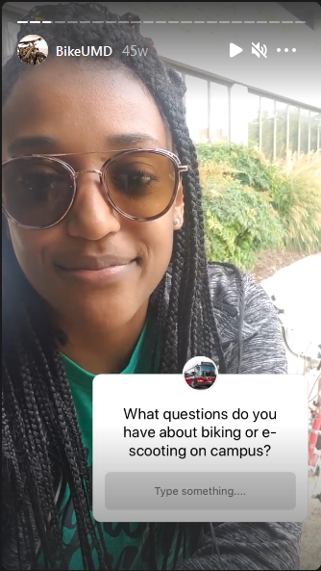
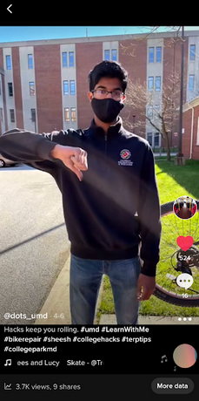
How DOTS uses short form video
Instagram Q&As
BikeUMD TikToks
Informational shorts with Adobe Spark

Slide 5
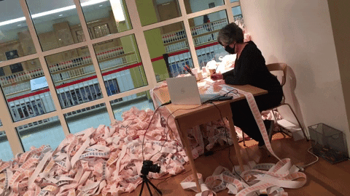
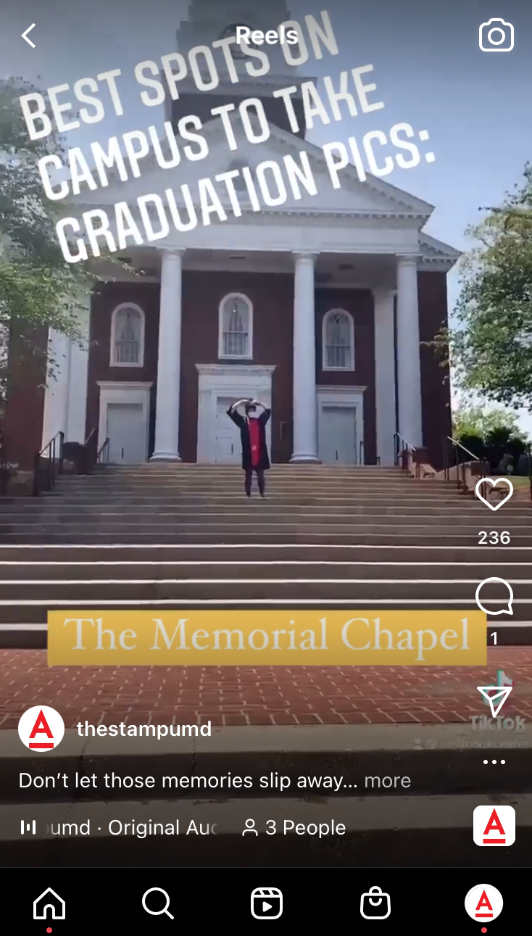
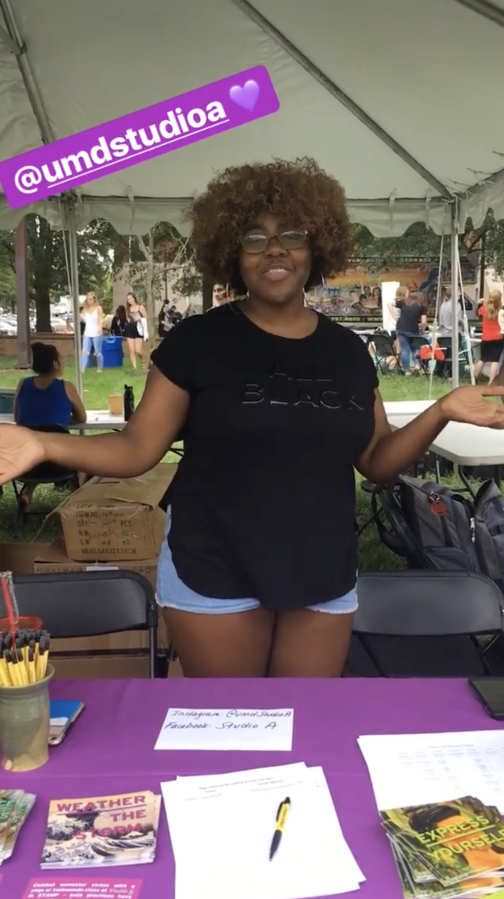
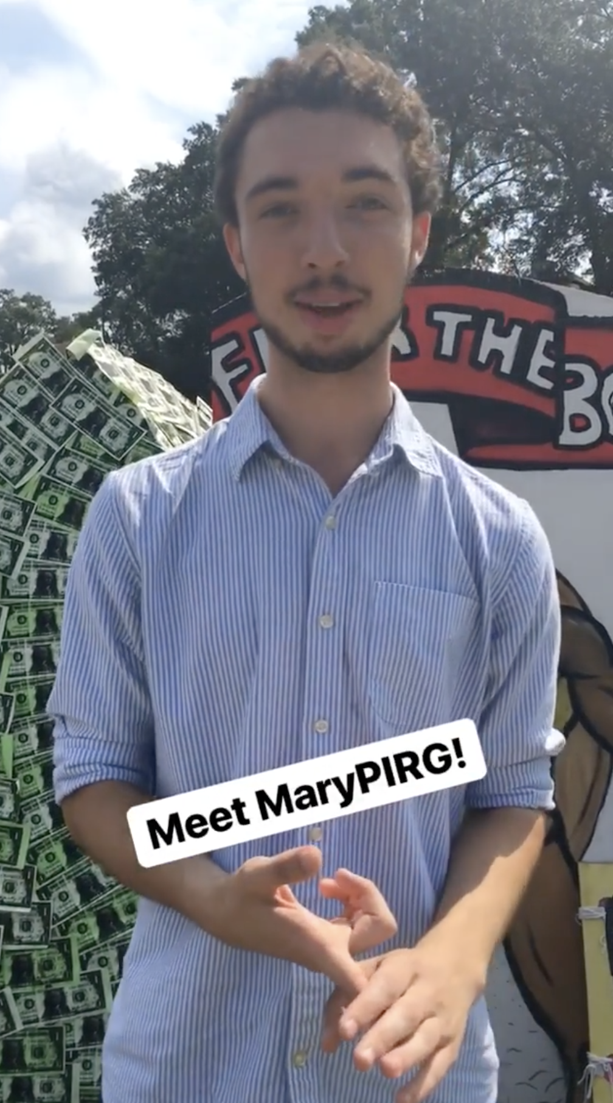
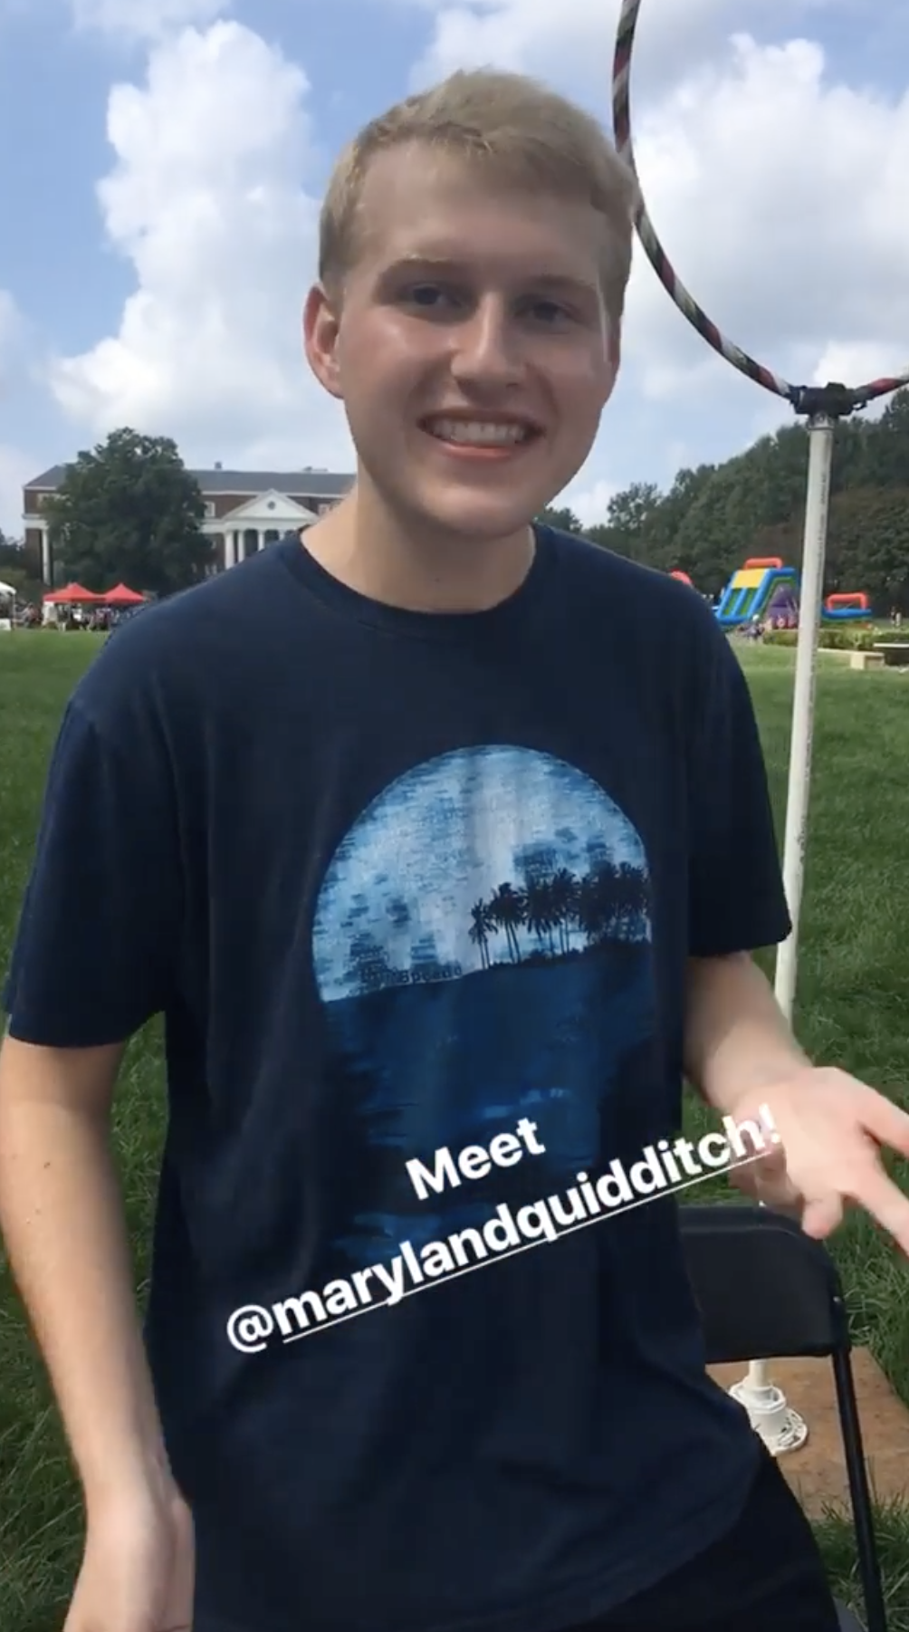
How STAMP uses short form video
1.
Instagram posts
Instagram Stories
Instagram Reels
1.
3.
2.
2.

Slide 6
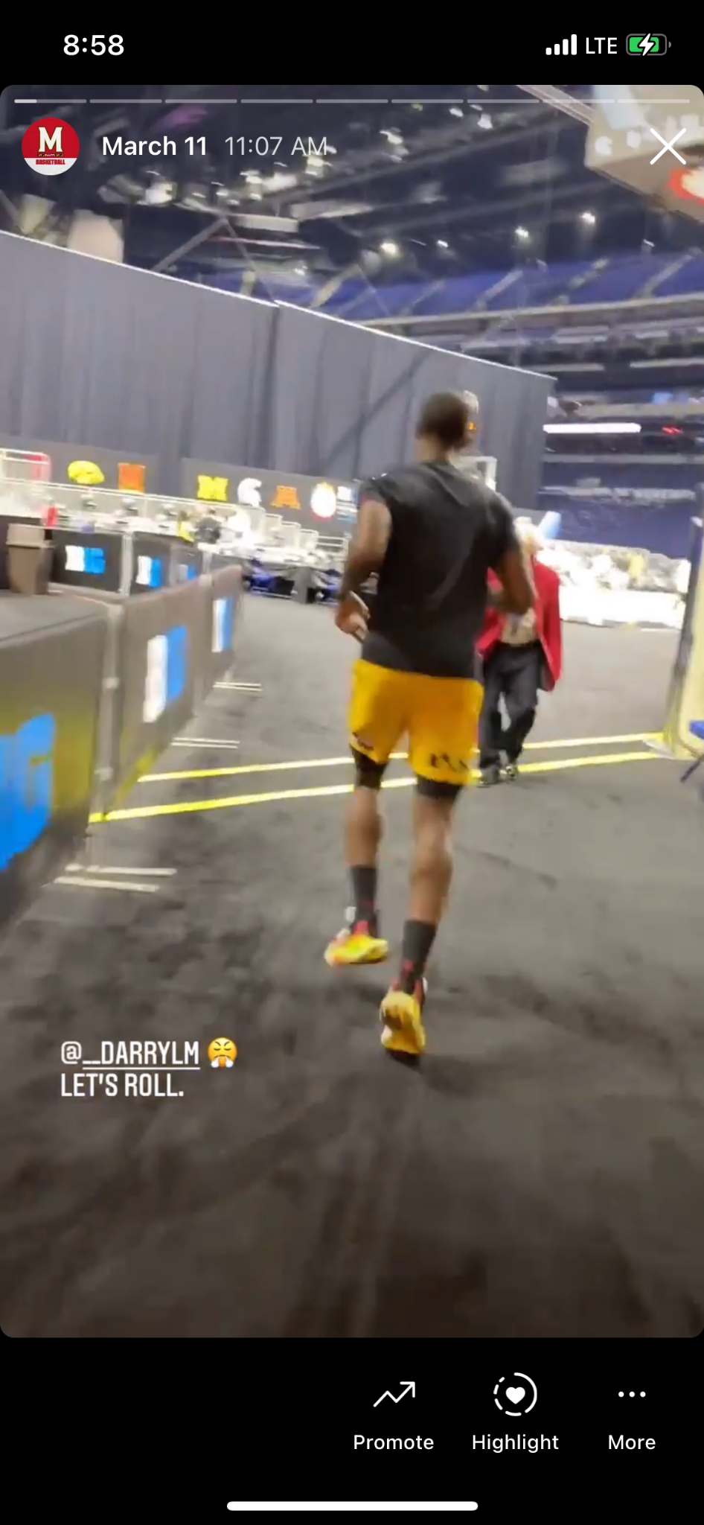
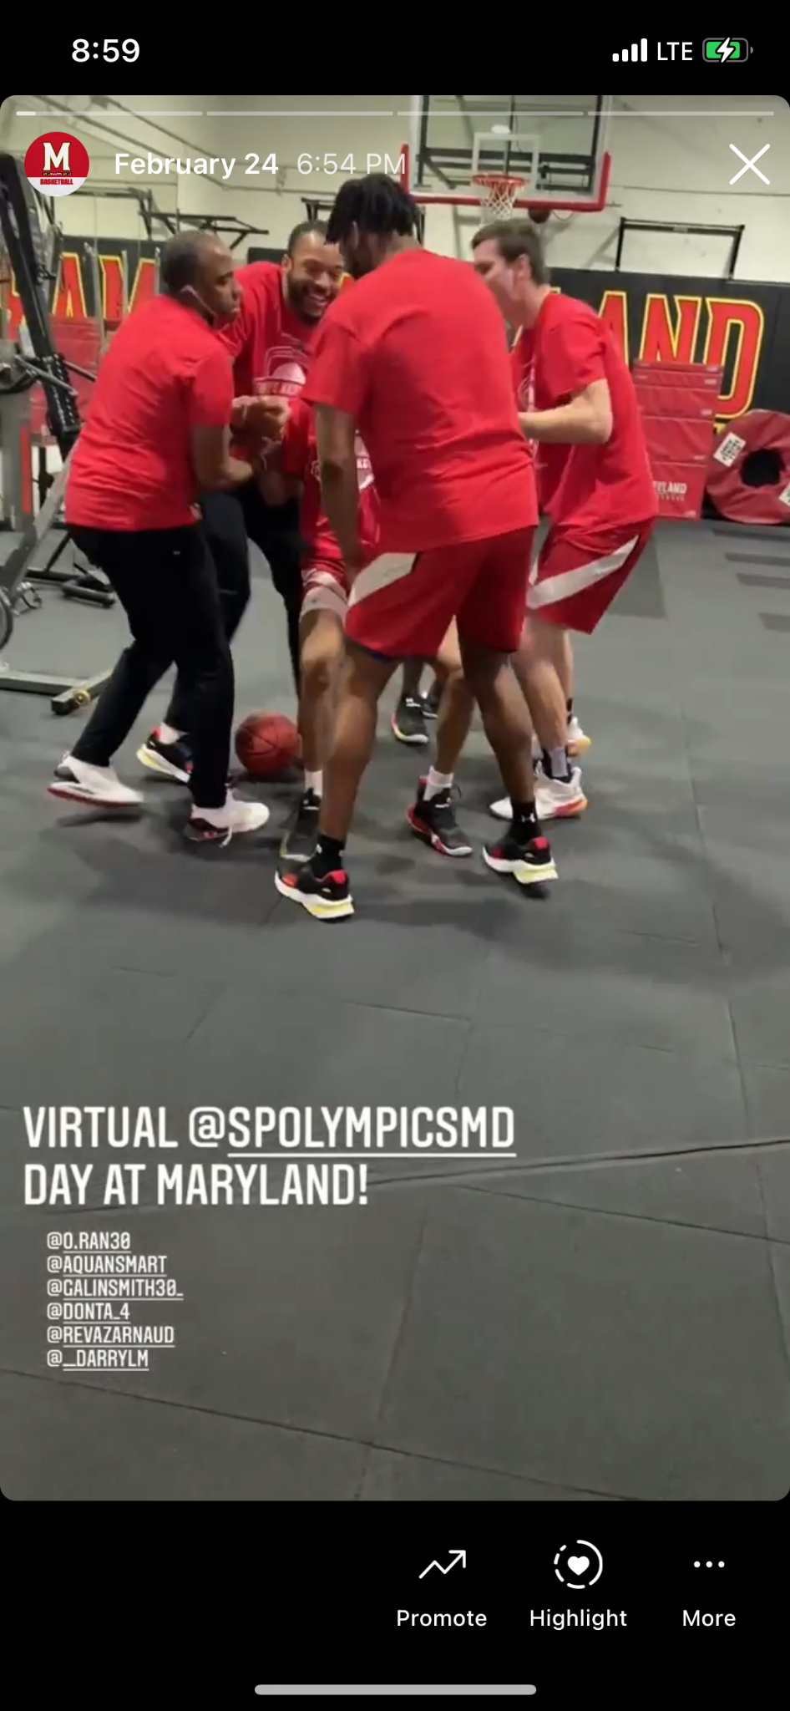
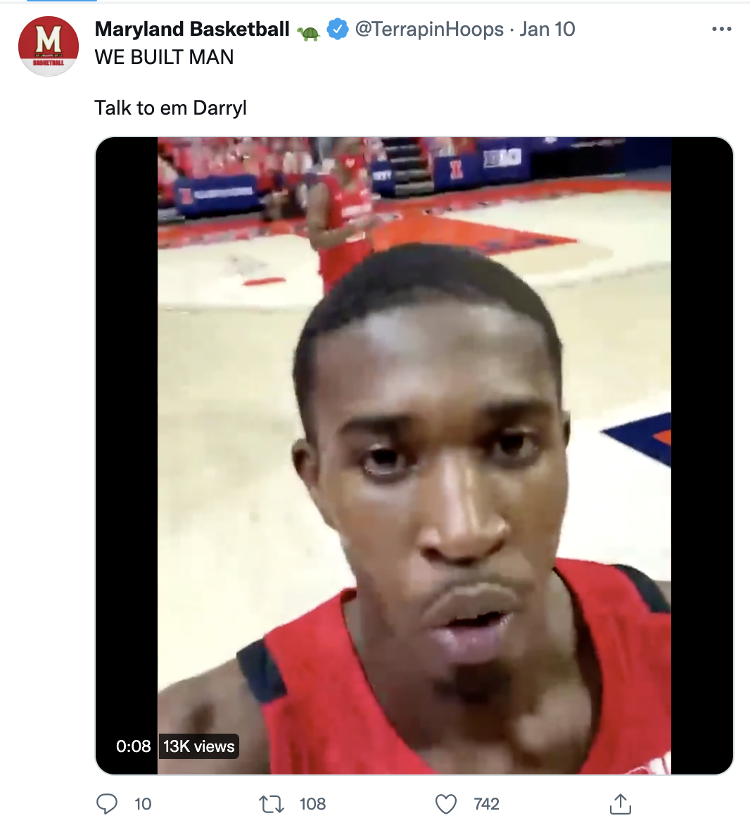
How Athletics uses short form video
Access
Personality
Values
(Everywhere)

Slide 7
Q&A Time!

Slide 8
End Slide

